Slide 1
SAS Studio
Programmers guide to analytics

Slide 2
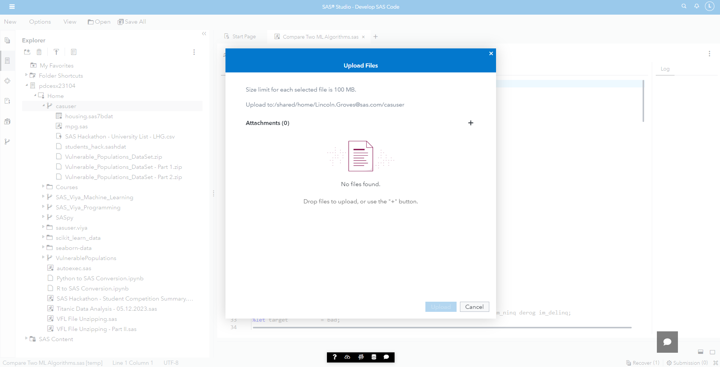
SAS Studio
Upload your data into SAS Viya for Learners

Slide 3
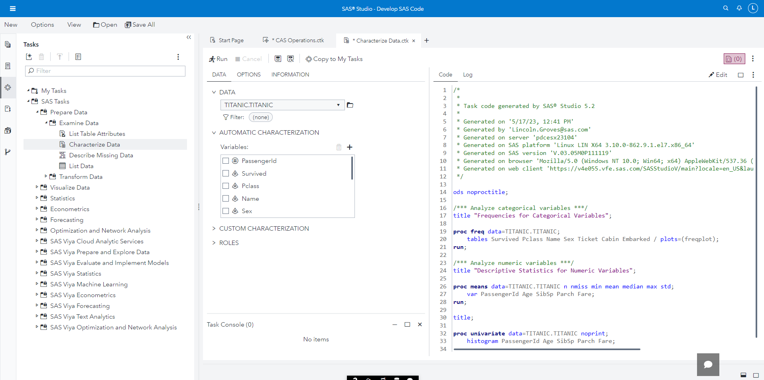
SAS Studio
Learn to code, Part 1: Tasks

Slide 4
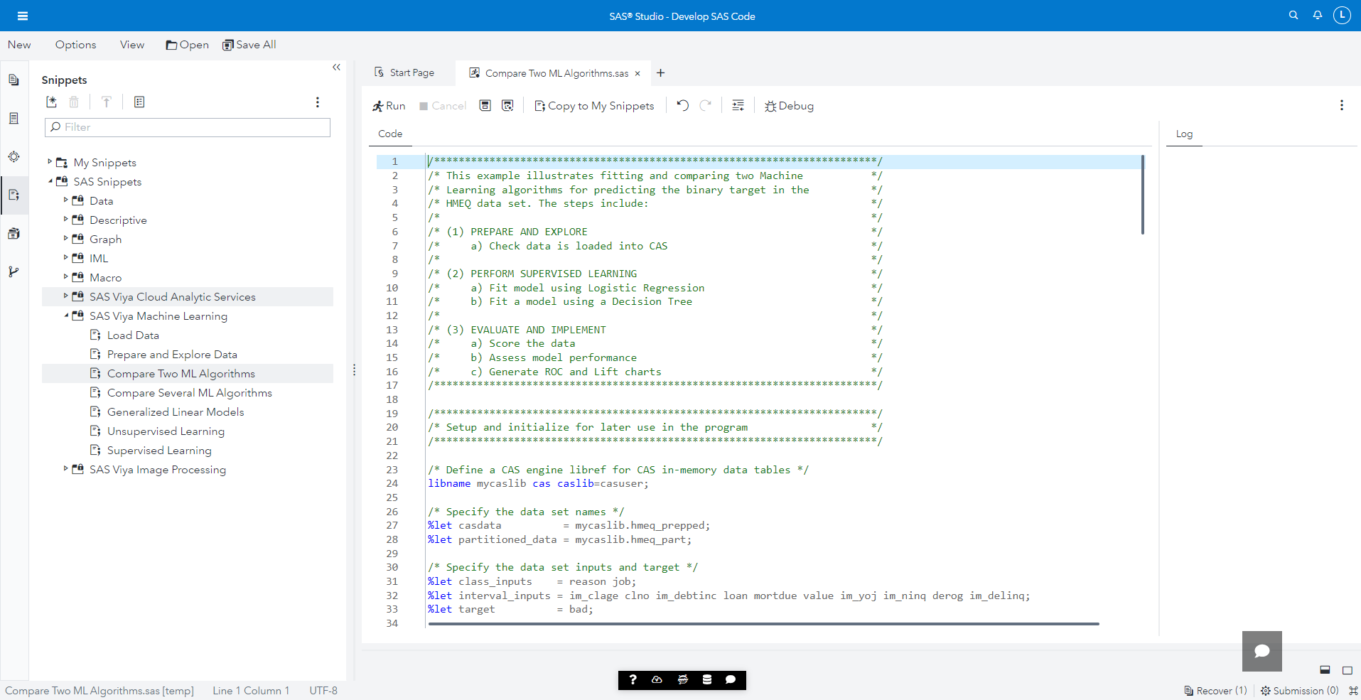
SAS Studio
Learn to code, Part 2: Snippets

Slide 5
SAS Model Studio
Where machine learning experts hang out

Slide 6
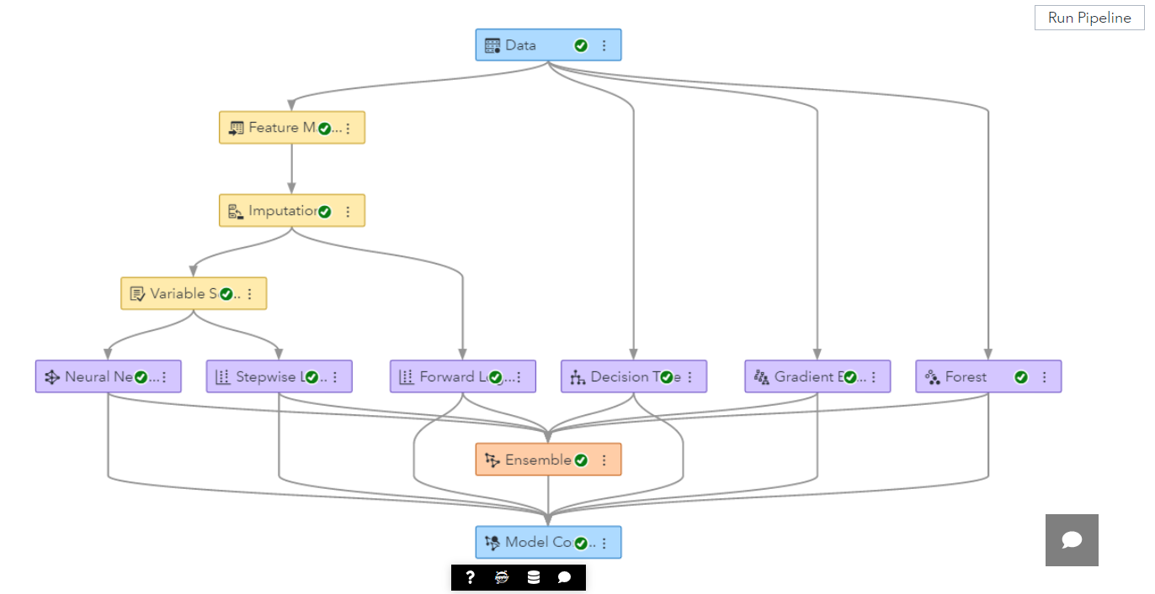
SAS Model Studio
Get to the good stuff faster | Automated Pipelines

Slide 7
Jupyter
Where to get your open-source fix

Slide 8
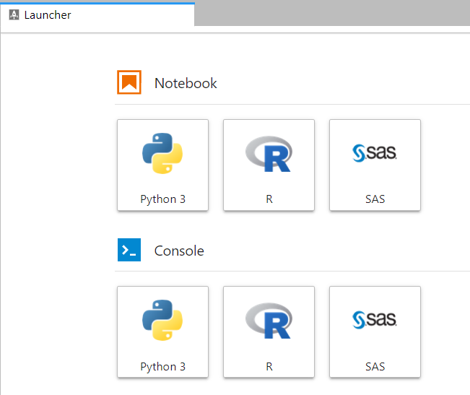
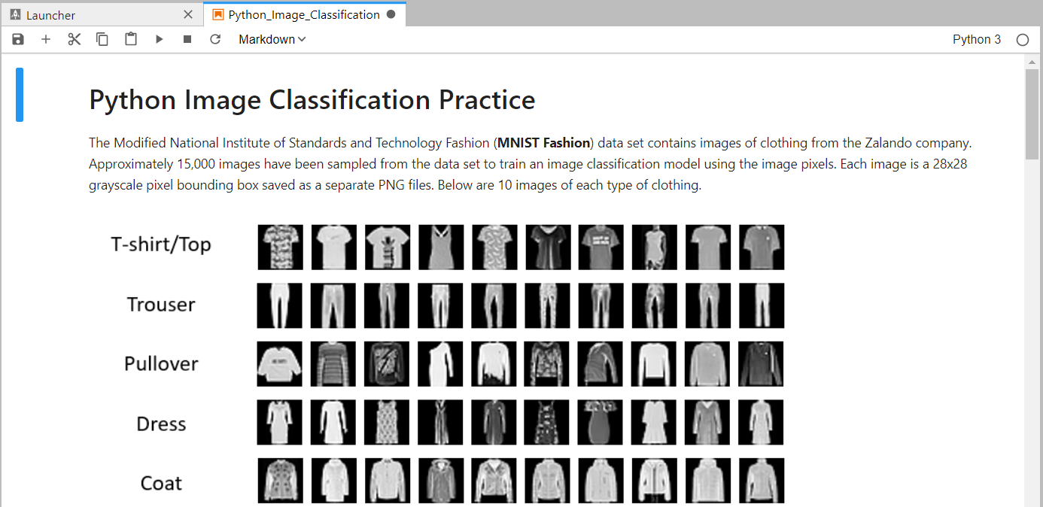
Jupyter
Better together | Run R, Python, and SAS Notebooks

Slide 9
SAS Visual Analytics
Dashboarding approach to analytics = analytics for all

Slide 10
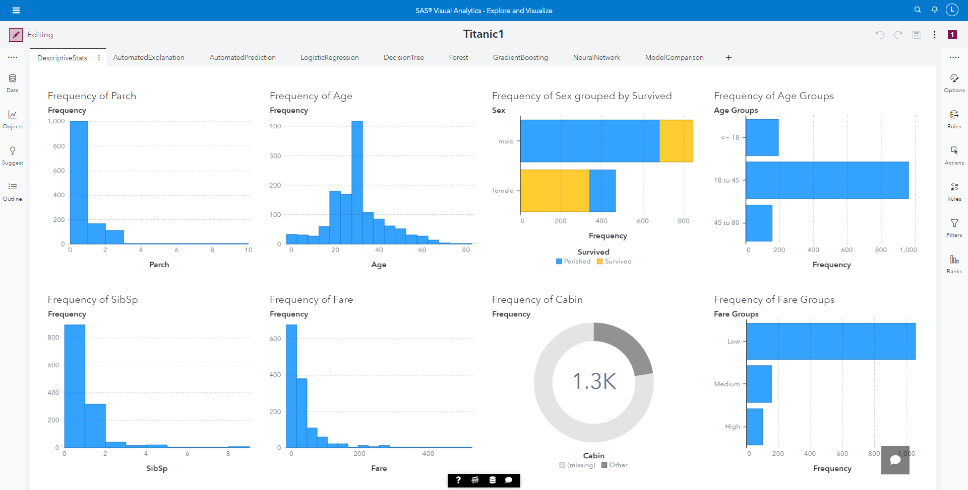
SAS Visual Analytics
Utilize dynamic dashboards to help with storytelling

Slide 11
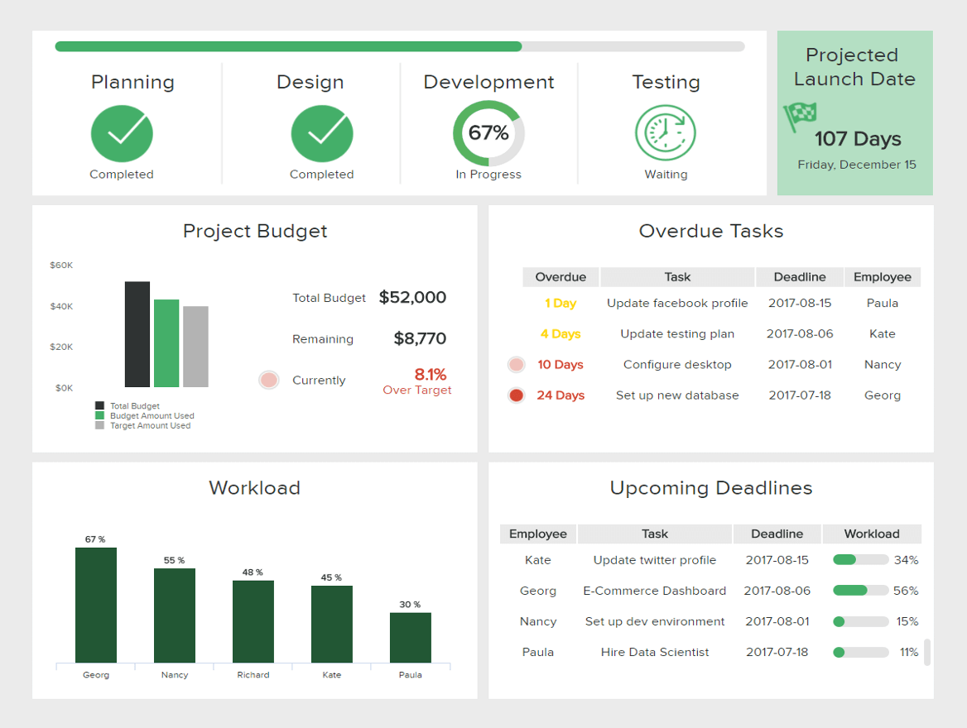
Dashboarding Techniques
Determine your goals.
Use the right chart type.
Consider your audience.
Choose relevant KPIs.
Tell a story with your data.
Provide context.
Be careful with colors.
Choose your layout carefully.
Be consistent.
Use interactive elements

Slide 12
Draft a Plan
Choose the Best Chart
Focus on What’s Important
Consider the Layout
Test, Test, and Test Again
Notes:
The top five steps of creating a dashboard in Visual Analytics: (1) Draft a Plan, (2) Choose the Best Chart, (3) Focus on What’s Important, (4) Consider the Layout, (5) Test, Test, and Test Again.

Slide 13
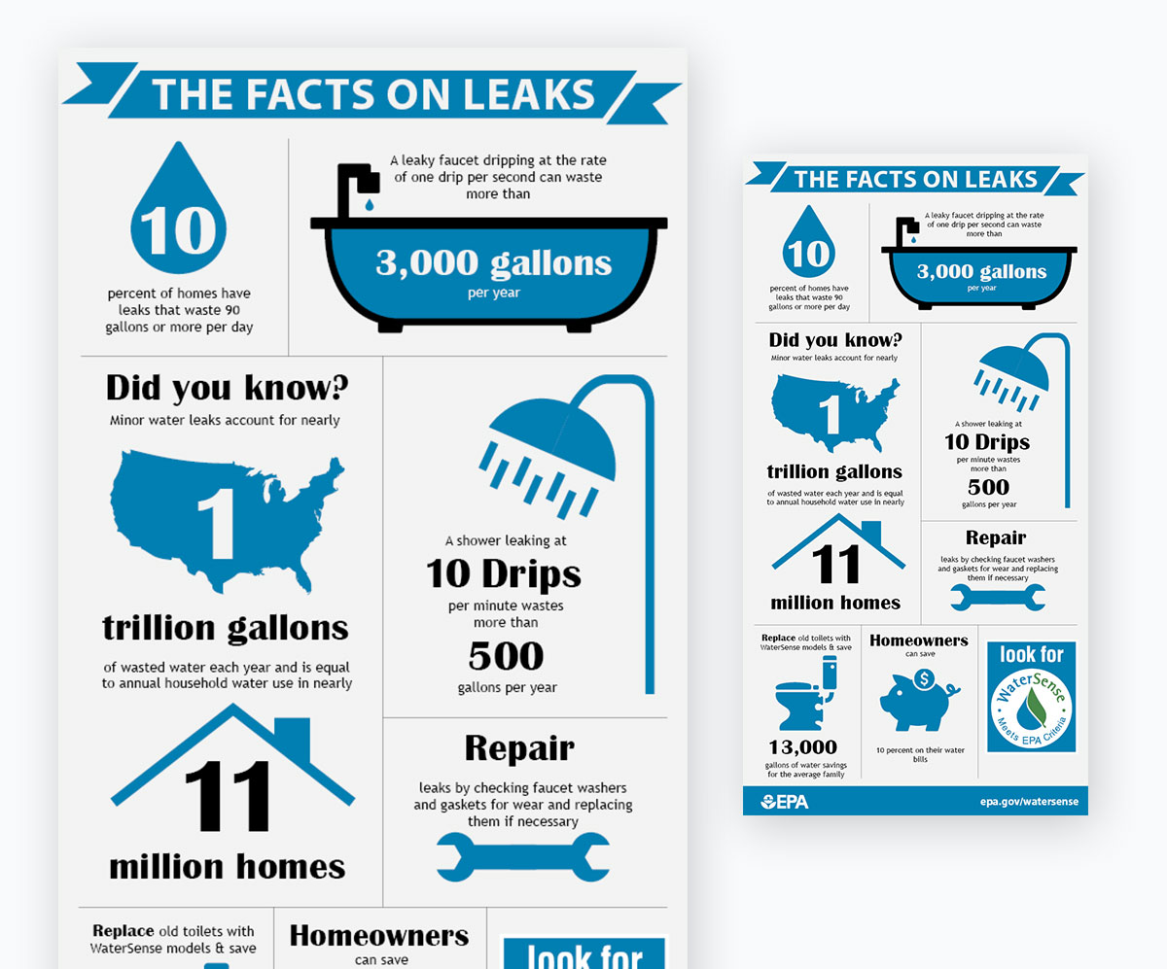
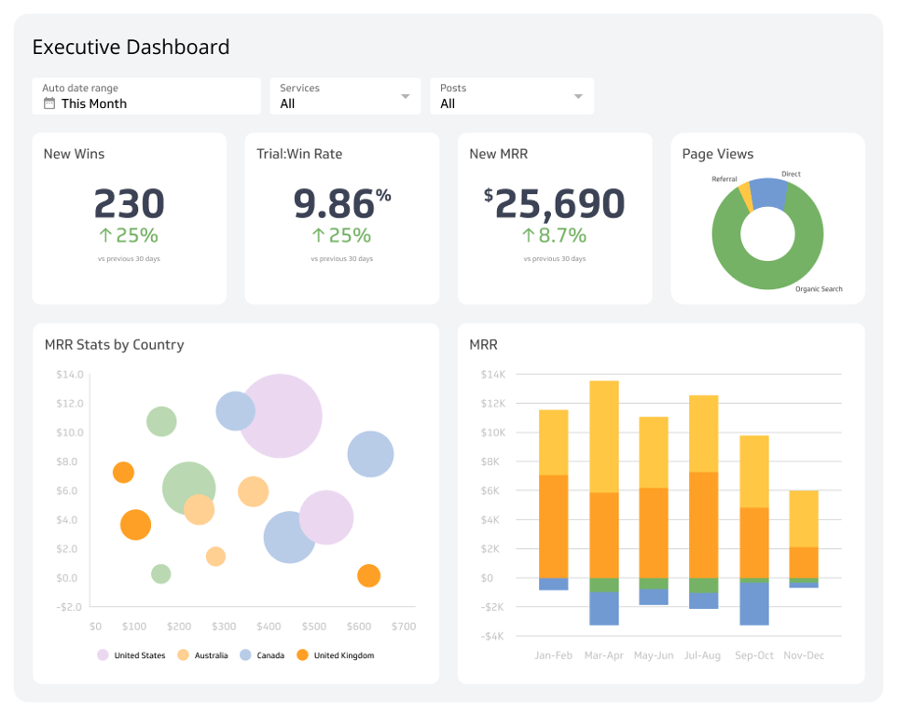
Infographic VS Dashboard
Broader, general audience
Visual representation of data designed to present information quickly.
Specific audience
Analyzing metrics to aid decision-making

Slide 14
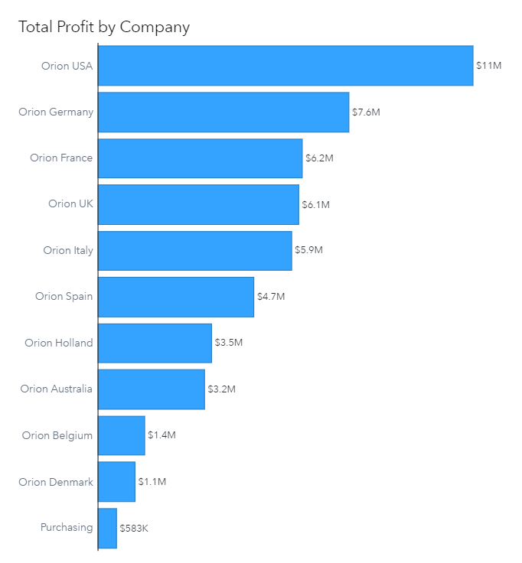
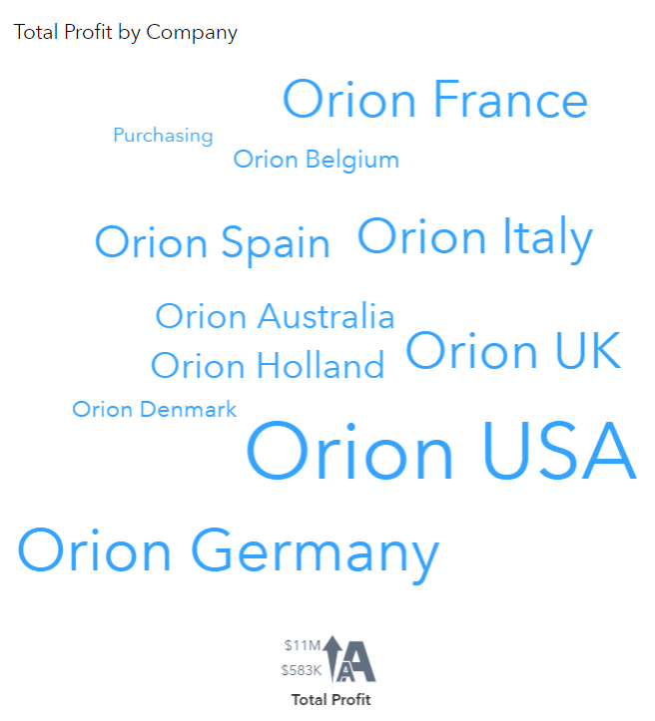
Use the simplest graph
Muddled message
Less accessible
Notes:
SAS® Visual Analytics makes it easy to tell your data story. Over 40 different visualizations, combined with powerful layout and design features mean you can tell virtually any data story in a way that makes impact.

Slide 15
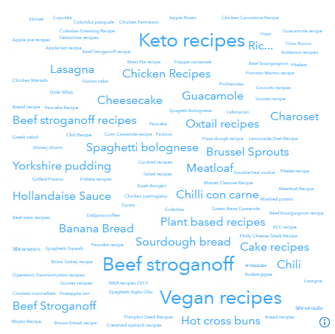

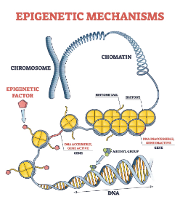
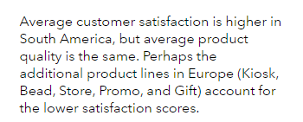
Is a graph required?
Word cloud
Images
Illustrations
Text object
Limit sensitivity characteristics (size, shape, position)
Notes:
Is a graph required? In some cases, word clouds, images, or illustrations created with the data-driven content object my better communicate the point. In addition, text can be used to give context to the value or state the conclusions that can be drawn from the data. When using text, avoid using sensory characteristics (like the size of the object, the shape of the item, or the position on the screen) as the sole means of conveying information or identifying a portion of the report.

Slide 16
Focus on What’s Important
Focus on a single idea
Use hidden and pop-up pages to provide details
Limit the number of objects
Multiple pages
Stand on its own
Limit the number of pages
Notes:
You can organize content by adding multiple pages to your reports. Each page in your report should focus on one aspect of the story and tell that piece with a limited number of objects. Not only that, but you must ensure that each page can stand on its own. Viewers should not be expected to remember details from one page to understand the concepts that are communicated on another page.
In addition to adding multiple pages to your report, you can create pages that provide additional details to report viewers: hidden pages and pop-up pages. These pages can be used to communicate details about the report to other designers, or they can be linked to from an object on a regular page to enable viewers to see additional details.
There is no limit to the number of pages that can be added to a report or the number of objects that can be added to a page. However, it is a good idea to limit the number of pages to make your report easier to access, easier to navigate, and easier to understand. If you need more than six or seven visible pages to tell your data story, you should consider creating multiple reports and use links between them to provide additional information.

Slide 17
Versatile Dashboards
Add Instructions
Ranks
Instructions for each page
Explain report actions
Focus on important values
Identify leaders or laggers
Actions
Add interactivity
Aid in self discovery
Animation
View changes over time
Focus on differences
Prompts
Focus on specific areas
Filter report or page
Links
Use automatic actions to speed up development
Provide additional information
Notes:
You can make your reports versatile (or interactive) by adding animations, ranks, prompts, actions, links, and setting the viewer customization level.
Animations can enable your users to view changes in data over time. When using animations, be sure to focus on changes that are different from the norm.
Ranks enable users to focus on the most important values and can be used to identify leaders (top values) or laggers (bottom values).
Report and page prompts can be used to help the viewer focus on areas that are important to them (by filtering the report and page, respectively). Consider the placement of prompts as you don’t want them to be overlooked and use titles to explain their purpose, how to use the prompt, and which elements are affected.
Actions can add interactivity to the report so users can explore data in a way that is meaningful to them. This will involve them in the data discovery process and will increase their motivation to act on their findings. Using automatic actions will enable the user to tailor their experience by specifying the order in which their actions are applied, making the report more dynamic and valuable.
Links can be used to provide additional information. Be sure to add instructions to explain which links are available and how they work (for example, do they filter the target data?).
The viewer customization level enables you to give users more control over the appearance of the report by modifying options, changing chart types, or selecting the data.
For accessibility, avoid linked selection actions. Screen readers cannot perceive elements that are highlighted with a linked selection action.

Slide 18
Color Choices
Excitement
Energy
Passion
Love
Danger
Revolution
Happiness
Optimism
Warmth
Joy
Cowardice
Caution
Nature
Freshness
Wealth
Youth
Depression
Jealously
Warmth
Autumn
Visibility
Harvest
Royalty
Wealth
Nobility
Honor
Immortality
Peace
Trust
Security
Sadness
Purity
Elegance
Peace
Cleanliness
Sophistication
Mystery
Formality
Death
Mourning
Illness
Notes:
Finally, you can add styles and display rules to make your reports more attractive. Be cognizant of color choices as they can affect the mood and the viewer’s reaction to a report object. Be aware that your color choices may change for different localities or regions.
WCAG (Web Content Accessibility Guidelines): https://www.w3.org/WAI/WCAG21/Understanding/non-text-contrast
For expression-based display rules, the label appears in the Display Rules pane and in tool tips for elements to which the display rule applies. The label is also announced by screen readers when users are viewing the report. Also, it’s recommended to only use a small number of display rules (2 to 3) to make your reports easier to understand and more accessible.

Slide 19
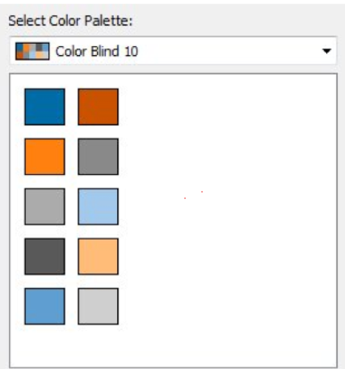
Accessibility
There are more than 350 million colorblind people in the world.
1 in 12 men (8%) and 1 in 200 women are colorblind.
Styles
Display rules

Slide 20
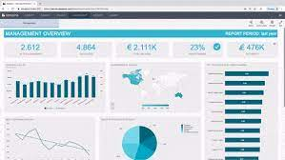
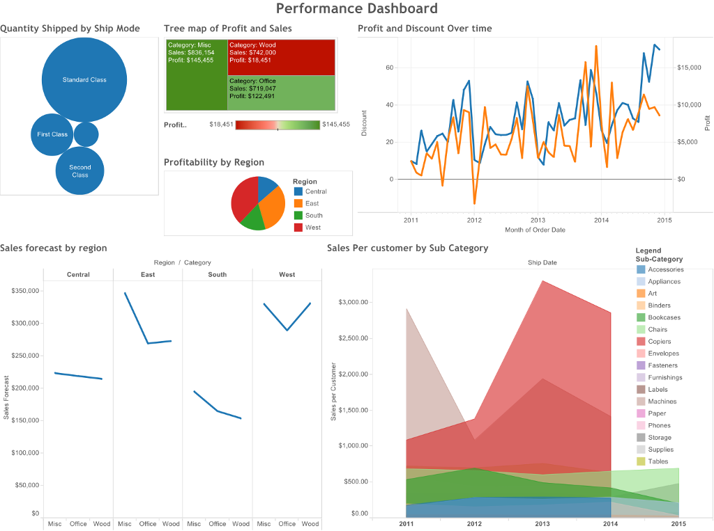
Choose your layout carefully
The general rule is that the key information should be displayed first – at the top of the screen, upper left-hand corner.
Notes:
Start with the big picture. The major trend should be visible at a glance. After this revealing first overview, you can proceed with more detailed charts. Remember to group the charts by theme with the comparable metrics placed next to each other. This way, users don’t have to change their mental gears while looking at the dashboard by, for example, jumping from sales data to marketing data, and then again to sales data. This analytics dashboard best practice will enable you to present your data in the most meaningful and clear way to the end user.

